Slide 1
Ray Tracing in Entertainment Industry
Tanaboon Tongbuasirilai
Dept. Computer Science
Kasetsart University
Week 12
Variance reduction

Slide 2
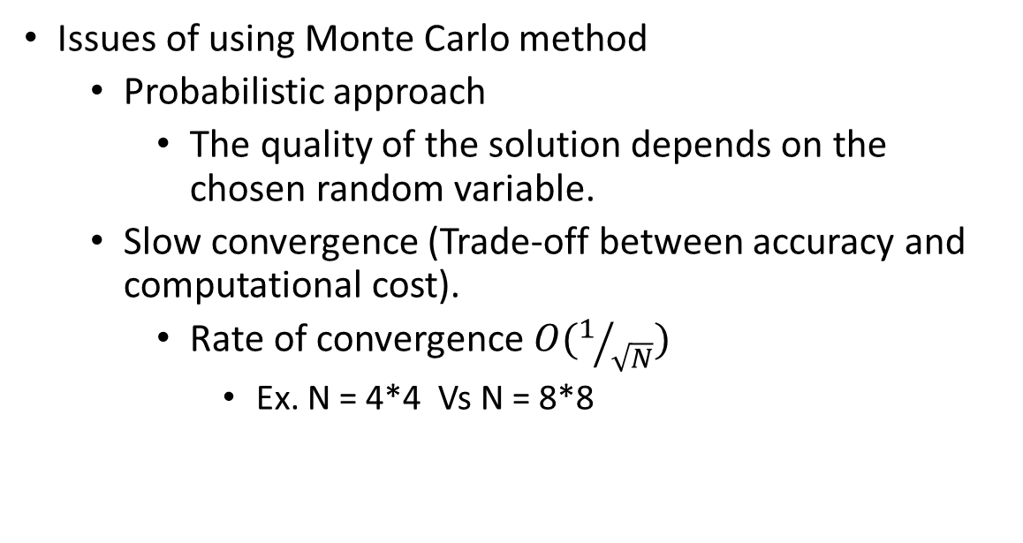
Monte Carlo method
Issues of using Monte Carlo method
Probabilistic approach
The quality of the solution depends on the chosen random variable.
Slow convergence (Trade-off between accuracy and computational cost).
Rate of convergence $O(1/{\sqrt{N}})$
Ex. N = 4*4 Vs N = 8*8
Notes:
Simpson’s rule has the rate of convergence O(1/n^4).
It is said that the rate of convergence is O(1/sqrt(n)). → slower than Simpson’s rule.
What happen to O(1/4) and O(1/8) ?

Slide 3
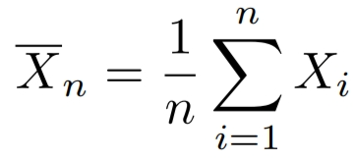
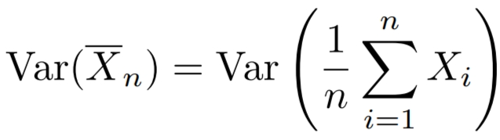
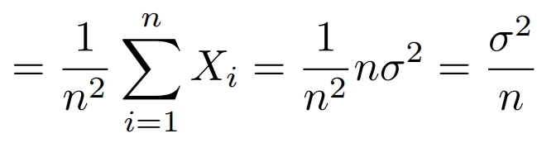
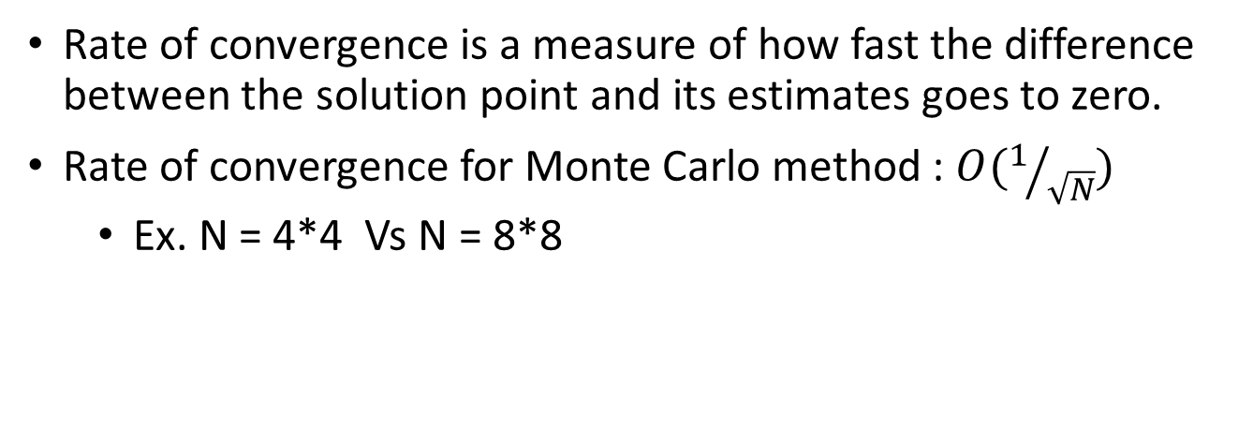
Rate of convergence
Rate of convergence is a measure of how fast the difference between the solution point and its estimates goes to zero.
Rate of convergence for Monte Carlo method : $O(1/{\sqrt{N}})$
Ex. N = 4*4 Vs N = 8*8
Notes:
[variance of the sample mean] -- What is the value of (variance / n) ?
Benefit ? → The variance does not depend on the number of integral dimensions.
Variance is reduced only by n → not n^2, n^4…

Slide 4
Path tracing and Uniform sampling
Applying Monte Carlo method to obtain a path tracing technique could not avoid the downside of the Monte Carlo method.
Previously, we employed the uniform sampling techniques for finding ray scattered directions. This ensures that our integrator could give the correct result (unbiased).
The uniform sampling sacrifices the computational power with the unbiased result.
How could we render scenes faster using a path tracer ?
Notes:
Path tracer
We require multi-dimensional integration.
Unbiased (The estimator is needed to be an unbiased estimator.)
Nature of the uniform sampling = unbiased.
The question below arises.

Slide 5
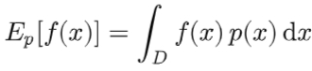
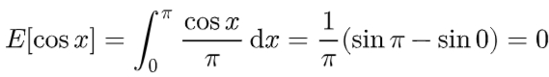
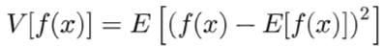
Expected value and Variance (Recap)
The expected value of a function is defined as the average value of the function over some distribution of values over its domain.
The variance of a function is the expected squared deviation of the function from its expected value.

Slide 6
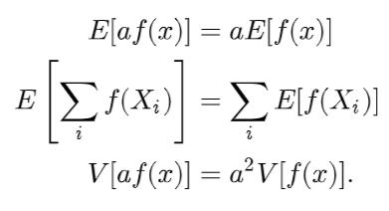
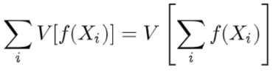
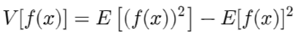
Properties of the expected value and variance (Recap)
Notes:
From the original variance equation, apply the properties then give the new formulation.

Slide 7
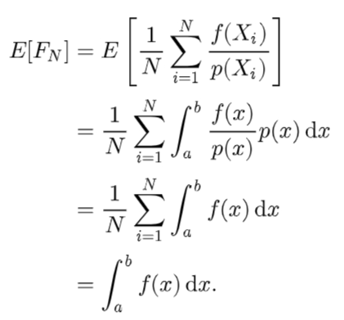
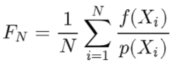
The estimator of the integral for arbitrary PDF (Recap)
Notes:
One solution to increase the speed of convergence is that → We need an arbitrary PDF and its estimator.
Why ?

Slide 8
Careful sample placement – Variance reduction 1
Stratified sampling
Quasi Monte Carlo
Notes:
2 choices for today’s lecture [ careful placing the samples ].

Slide 9
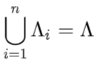
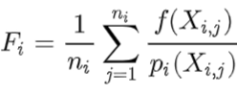
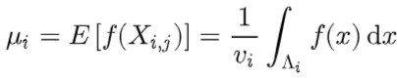
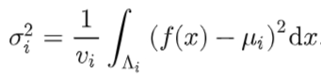
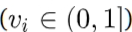
Stratified sampling
Union of non-overlapping strata.
If we draw samples independently of each stratum,
We get a monte carlo estimate of the stratum.
Fractional volume of stratum i
Notes:
Stratum i → has its own estimator, own mean and variance.
Fi -> estimator at stratum i.
Xi → samples at stratum i.
Pi -> pdf at stratum i.
Ui -> mean at stratum i.
Note that vi → fractional volume of stratum I = weight
Class participation… any other observation ?
f(x) is the same for all strata.

Slide 10
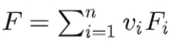
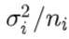
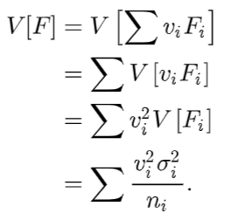
Variance reduced by the stratified sampling
Overall estimate
Variance per stratum
The total variance
Notes:
The total variance depends on…. ? [Class participation]
vi and ni → weights and samples
Easiest way is to choose the same weight for all strata.

Slide 11
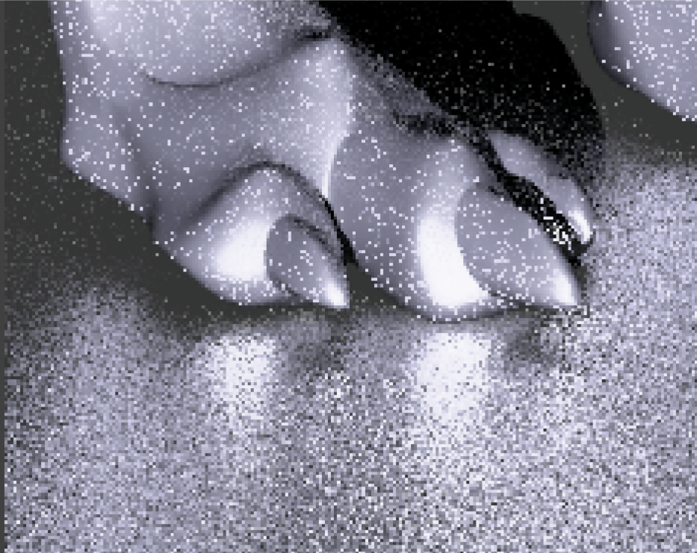
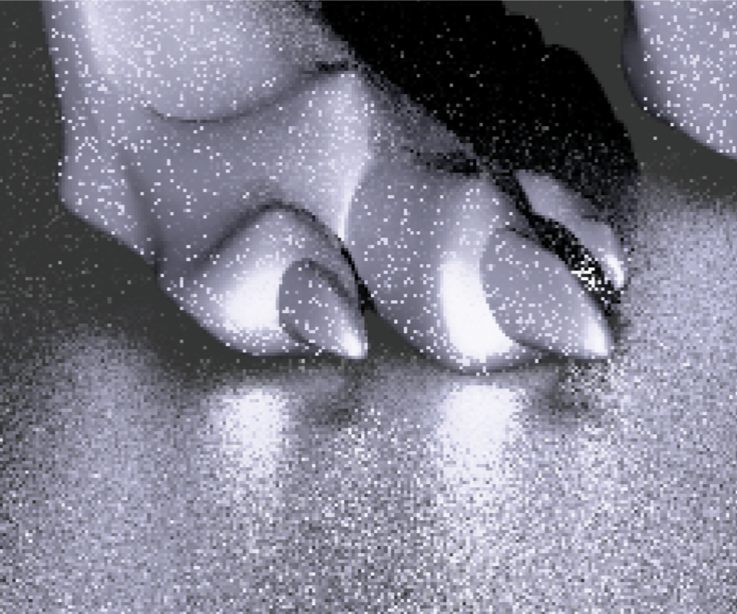
Result
Uniform sampling
Stratified sampling

Slide 12
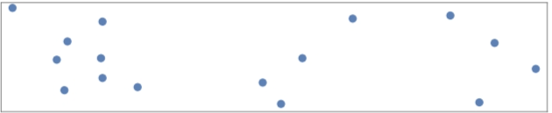
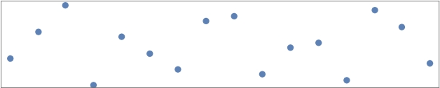
Quasi Monte Carlo sampling
Low discrepancy sampling
Halton sampling
Hammersly sampling
(0,2) sequence sampling
New pseudo random generator
Quasi random sampling
Stratified sampling
Quasi sampling
Notes:
[Class participation] The difference between stratified and quasi in the pictures ?
Stratified → high gap
To lower gap we need
How to sample with low discrepancy policy.
Change the random number generator.

Slide 13
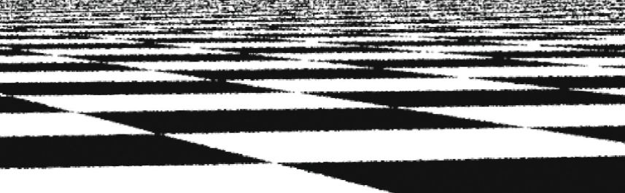
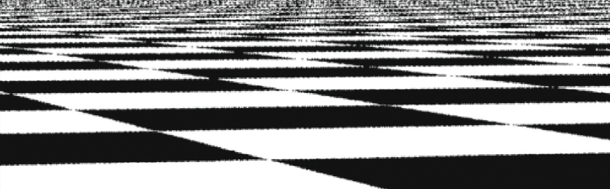
Comparison
Jittered stratified sampling
Halton sampling
https://www.scratchapixel.com/lessons/mathematics-physics-for-computer-graphics/monte-carlo-methods-in-practice/introduction-quasi-monte-carlo.html
https://pbr-book.org/3ed-2018/Sampling_and_Reconstruction/The_Halton_Sampler
https://pbr-book.org/3ed-2018/Sampling_and_Reconstruction/(0,_2)-Sequence_Sampler

Slide 14
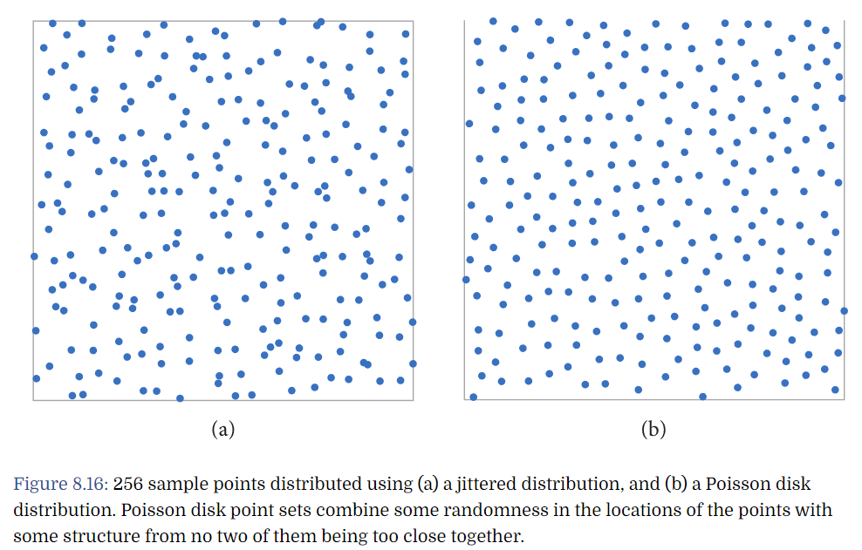
Well-distributed samples
https://pbr-book.org/4ed/Sampling_and_Reconstruction/Sampling_and_Integration
Notes:
Low discrepancy != well distributed sampling
This is a case when poisson disk sampling is used. → not a good choice for low discrepancy.

Slide 15
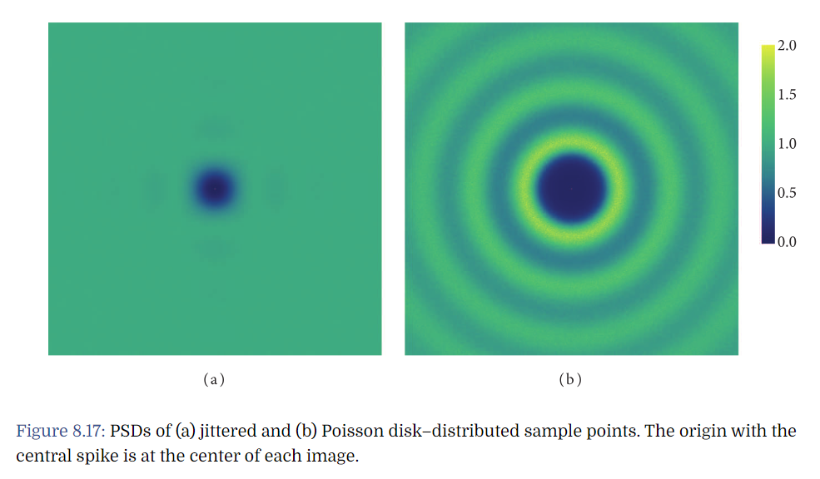
Power Spectral Density (PSD)
Notes:
Fourier analysis → obtain PSD

Slide 16
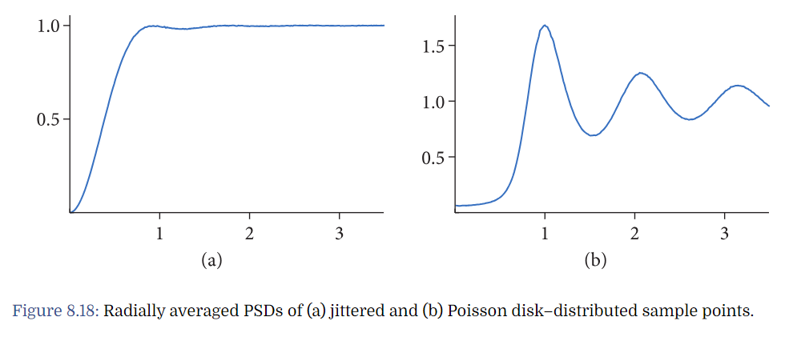
Radially averaged plots
Notes:
Using Fourier analysis of variance, it can be shown that due to this lingering energy, the variance when using Poisson disk sampling is worse than jittered points for some integrands.

Slide 17
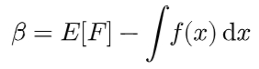
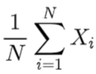
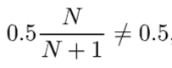
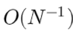
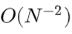
Bias – variance reduction 2
An estimator is unbiased if its expected value is equal to the correct answer.
The difference, between the estimator and its expected value, is called bias.
A uniform distribution X_{i}
mean
variance
Lower variance
Notes:
Adding bias to estimators
2 choice of mean calculation.
[Class participation]
Observe the right formulation → what implication you get ?
The solution is not exact (close to the theory).
But converge faster
Is bias is acceptable ? → the question when we want to add bias.

Slide 18
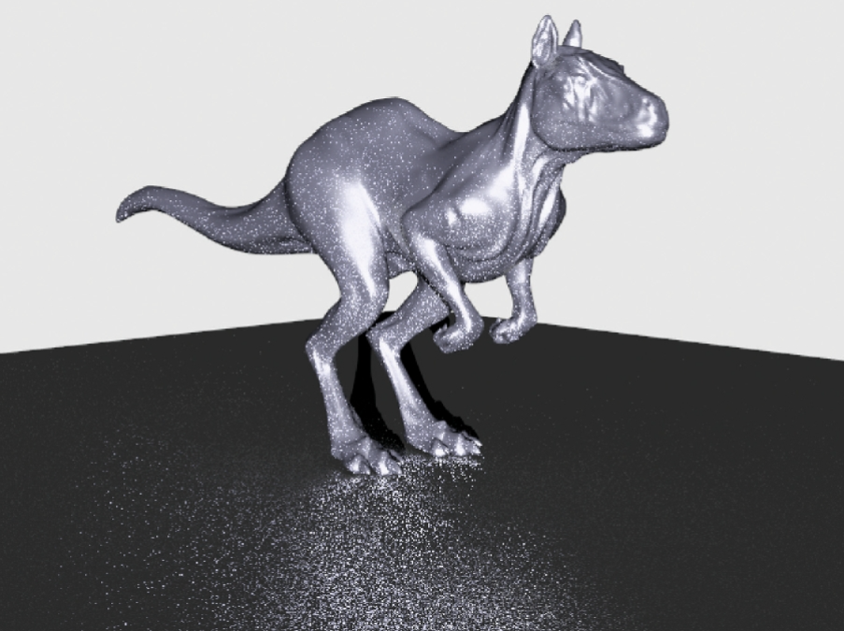
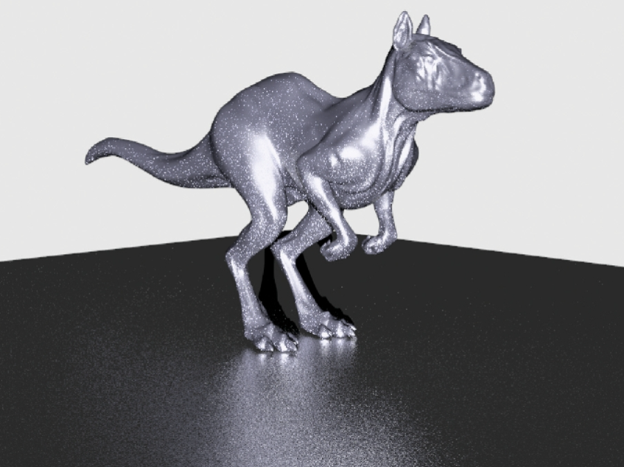
Importance sampling – variance reduction 3
Uniform BSDF distribution
BSDF importance sampling
Notes:
The main and critical method → popular these days.
The same number of samples but converge faster. (lower noises)
Both practically and theoritcally

Slide 19
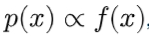
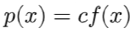
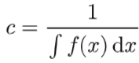
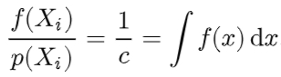
Lower variance through choosing suitable PDF.
If the chosen PDF, p(X_{i}), is similar to the estimated function, f(X_{i}).
The resulted estimator, F_{N}, is (almost) a constant.
Variance = 0
Notes:
The upper left box = the estimator
The lower left box = proof of the estimator
Drawing samples proportional to the integrand f(x).
If the coefficient ‘c’ is 1/solution.
There is a theoretical guarantee that the variance is super low = 0.
But this is not the case.
It is acceptable that we choose p(x) according f(x) is somewhat satisfied low variance.

Slide 20
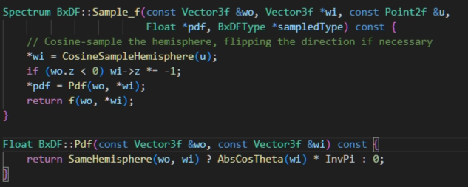
Sampling BRDF (BSDF, BXDF) in PBRT
Notes:
Showing PBRT codes → website
Pdf = cosine value
Sample_f = choosing scattered direction proportional to the cosine sampling on hemisphere.
[Class participation] - Sample_f() is similar to what function in our practices ?
The steps
Choose the scattered direction (based on u1, u2)
Compute the pdf (based on wo, wi)
Compute the BRDF value
In Sample_f() → we want to sample ‘wi’ given that we have ‘wo’ and ‘u’ (2 uniform random variables).
Note that the scattered direction depends on the ‘u’.

Slide 21
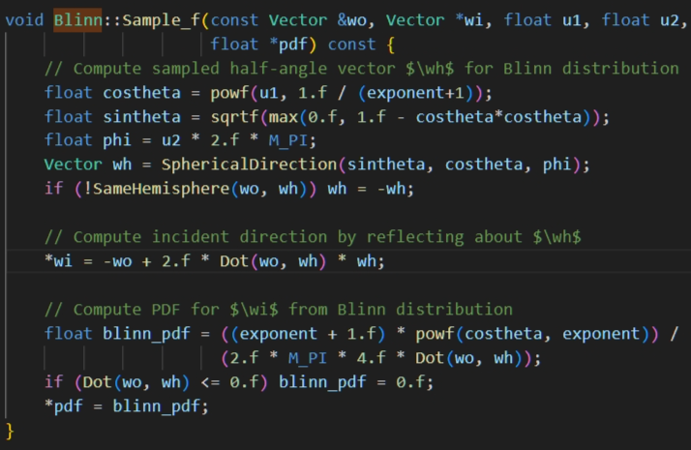
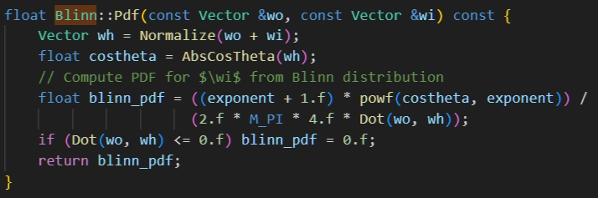
Blinn sampling
Notes:
One example → Blinn-Phong BRDF
The scattered direction depends on wh → from u1 and u2.
The pdf also depends on wo, wi → wh, wo.

Slide 22
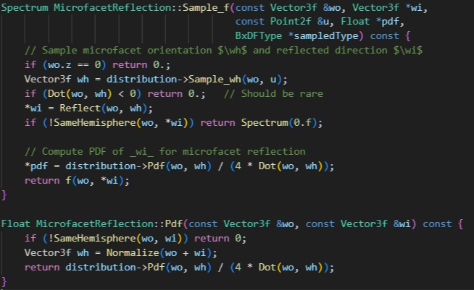
Microfacet Reflection sampling
Notes:
Microfacet Reflection → Cook Torrance model

Slide 23
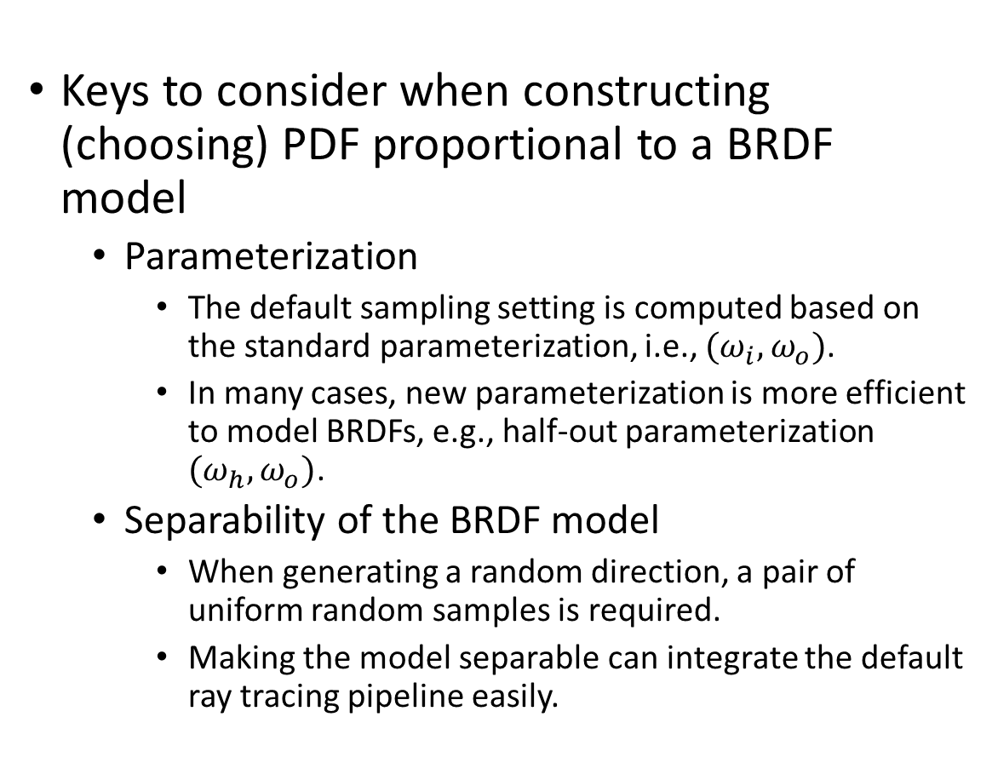
Sampling directions proportional to a BRDF model.
Keys to consider when constructing (choosing) PDF proportional to a BRDF model
Parameterization
The default sampling setting is computed based on the standard parameterization, i.e., ${(ω}_{i}, ω_{o})$.
In many cases, new parameterization is more efficient to model BRDFs, e.g., half-out parameterization ${(ω}_{h}, ω_{o})$.
Separability of the BRDF model
When generating a random direction, a pair of uniform random samples is required.
Making the model separable can integrate the default ray tracing pipeline easily.

Slide 24
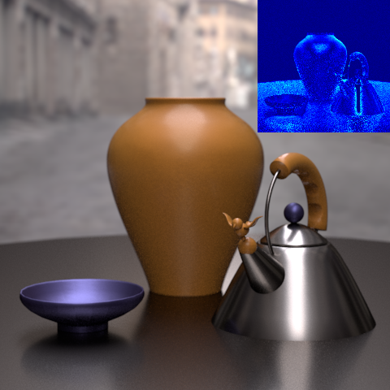


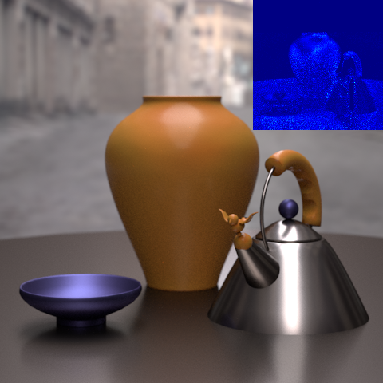
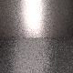
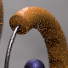



Model quality
Lawrence et al.[2004]
Jason Lawrence, Szymon Rusinkiewicz, and Ravi Ramamoorthi. "Efficient BRDF Importance Sampling Using a Factored Representation.“ ACM Transactions on Graphics (Proc. SIGGRAPH), August 2004.
PSNR=33.40dB
Our
PSNR=37.37dB
Generated with low number of samples
(Importance sampling)
PSNR=35.27dB
Bilgili et al.[2011]
Ahmet Bilgili, Aydn Öztürk, Murat Kurt. A General BRDF Representation Based on Tensor Decomposition, Computer Graphics Forum 30(8):2427-2439, November 2011.
Notes:
Talk about the PDV paper.
What is PSNR ?

Slide 25

Parameterization affects the rendering quality
https://diglib.eg.org/bitstream/handle/10.2312/conf.EG2013.tutorials.t6/5_Ruiters_TA_graphics_applications.pdf?sequence=7&isAllowed=y

Slide 26





Different parameterizations, different sampling stratergy
Notes:
This leaves room for better data representation and sampling strategy.

Slide 27






Transformation between distributions
Example
*T(X) is bijective.
J_{T}(x) is the determinant of the Jacobi transformation of T(X).
https://pbr-book.org/3ed-2018/Monte_Carlo_Integration/Transforming_between_Distributions
Notes:
One important issue when constructing new parameterization.
Rendering → standard parameterization (wi, wo) → pdf according to (wi, wo)
Sampling and calculating pdf in another domain needs to be transformed to original domain of the rendering engine (wi, wo).

Slide 28


Jacobian transformation of the PDV parameterization
Projected Deviation Vector (PDV)
Notes:
But sometimes the jacobian might cause the problem.

Slide 29




A mathematical framework for plug in 2 uniform random variables : Example -Uniform Sampling a Hemisphere
A marginal density function
The corresponding density
Separating variables.
Cumulative Distribution Functions
Constructing CDFs.
Final outcome for uniform random samples
Notes:
In uniform sampling on a hemisphere, we have a joint pdf.
We want to Separate variables from joint pdf sampling.
We want to find a way to plug in u1, u2 when choosing the scattered direction and calculating pdf.
Maginal density function → leave one parameter out from the joint pdf.
We also need a corresponding density (given a parameter what could be an appropriate pdf of 2nd parameter according to the given one.).

Slide 30








Cosine-Weighted Hemisphere Sampling
Sample a direction propotional to cosine
The PDF corresponding to the above cosine
Sampling on a unit disk is more efficient.
Want to transform between distributions ?
Notes:
Another example : cosine-weighted hemisphere sampling
The left is the solution.
The green is how we derive the left solution.
The upper right equation is how u1 and u2 work on the solution. (using the previous math framework)
.
Note that this is a general solution of the uniform sampling.

Slide 31






Microfacet distribution Importance Sampling
Beckmann–Spizzichino distribution
separable
Constructing a CDF
Notes:
When it comes to a non-uniform pdf, we want to draw samples according to a function.
Microfacet BRDF has microfacet distribution.
We make use of that distribution function hence we can call it importance sampling.
.
This slide shows how we integrate the math framework to find an importance sampling strategy from microfacet model.

Slide 32


Half vector related to the distribution
Notes:
Another way to transform between halfway vector and incoming (or outgoing) vector.
A mathematical derivation is presented on this slide.

Slide 33





Light Sampling – variance reduction 4
3
1
2
4
Notes:
One way we could reduce the variance is to sample more on light area.
Imagine that non-light sampling direction leading to higher noises (indirect illumination).
Adding light sampling could help ease the noise. (direct illumination)
.
Step 1 – defining dw – angular area = area weighted by cosine and its distance.
Step 2 – defining pdf of sampling on light source area. – uniform sampling = 1/area
Step 3 – probability of choosing direction (w) = probability choosing point in the area (A)
Step 4 – deriving the probability of choosing the direction

Slide 34

Light sampling results
Notes:
[Class participation] Let’s discuss what you see !
Does it make better sense ?

Slide 35


Comparison
Notes:
[Class participation]
Let’s discuss more !
Which one combines light + cosine sampling ? (left) (This one takes 1000 samples.)
The right one is only light sampling (less indirect illumination). (but this takes only 10 samples.)

Slide 36


More

Slide 37
Keys to do light sampling
Direct light sampling
Avoid computational overhead for auxiliary paths (scattered directions).
Ease of implementation.
Point light
It is a delta distribution in which sampling problem is trivial.
The PDF is 0 as there is no chance to sample other than only at the point.
Other light shapes
Each shape requires its own PDF.
Quad
Triangle
Sphere

Slide 38

Multiple Importance Sampling – variance reduction 5
What if the integrand is the product of functions ?
This requires different sampling strategies for each estimator.
Multiple importance sampling (MIS) addresses exactly this issue, with a simple and easy-to-implement technique. The basic idea is that, when estimating an integral, we should draw samples from multiple sampling distributions, chosen in the hope that at least one of them will match the shape of the integrand reasonably well, even if we don’t know which one this will be.
https://pbr-book.org/3ed-2018/Monte_Carlo_Integration/Importance_Sampling
Notes:
Previously we considered an integrand with a function. But what if it is a product of functions ?

Slide 39



The MIS estimator
Choices of weighting functions. (Constraints)
Power heuristic
Balance heuristic
Notes:
An example when the estimator is two estimators ( f(x) and g(y) ).
We draw samples based on both pf(x) and pg(y).
We also need weights for both estimators.
.
The weight function (for this lecture) has 2 choices.

Slide 40

What each of the estimator means
Sampling from BRDF
Sampling from light
Notes:
The rendering equation can be matched to multiple estimators.

Slide 41


Observing an estimator
If it is similar to f(X), the variance is high due to g(X).
Choosing p_{f}(X)
If it is similar to g(X), the variance is high due to f(X).
The weighting functions address this issue.
Notes:
The Weighting function balance the variance.

Slide 42


MIS result
MIS
BRDF sampling
Light sampling

Slide 43

Cornell box
MIS
BRDF sampling
light sampling

